Slide 1
Open Payments
Third-party Account Access
Chen Hui Jing
Last update: Feb 2025

Slide 2

Link to these slides

Slide 3
Our Goals
Send a payment as easily as an email
Use interoperable, open standards
Enable digital financial access & inclusion

Slide 4
The Status Quo
Financial institutions have their own internal systems, making direct money transfers between different systems difficult.
Either connect via:
custom integrations, which are costly, time-consuming, and prone to errors.
intermediaries, which increases costs and adds delays.

Slide 5
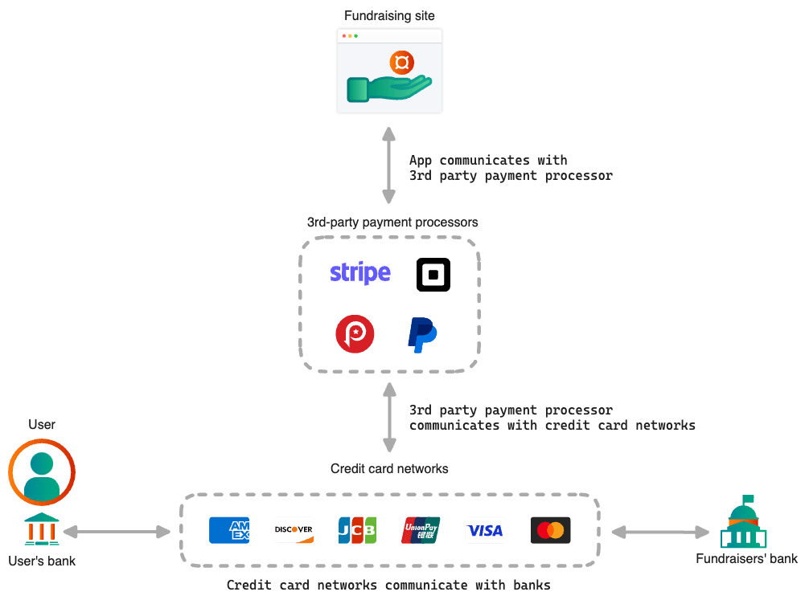
The Problem
Online payments are complicated
Insecure
Typically require intermediaries
Opaque
Notes:
I always like to start with the problem
Digital payments are everywhere…
There are problems with how money currently moves between customers and online applications.
Intermediaries
Simplicity and abstraction
Fees and delays
vendor lock in
expose sensitive info
Direct Integration
lower transaction fees
increased control
development complexity
not always possible
Exponential problem
Unbanked, mobile money

Slide 6

Where Interledger Comes In
Standardisation
Open protocol for seamless value transfer.
It gives us scalable, secure, interoperability.
Crypto Wallet
Crypto Wallet
Custom Integration
Interledger
Digital Wallet
Digital Wallet
Custom Integration
Interledger
Bank
Bank

Slide 7
Interledger Protocol (ILP)
The Protocol Suite
Protocol suite
Layered architecture
Ledgers: outside of ILP suite. Are the systems that keep track of value.
SPSP Open Payments
Application
STREAM
Transport
ILP
Protocol
BTP ILPoverHTTP
Link
FIAT CRYPTO
MOBILE MONEY
Settlement
Notes:
Enabling:
Cross-Border payments
Cross-currency payments
Financial inclusion - access to digital finance or better digital finance
Micropayments - sending small payments (fractions of a cent)
Financial systems are isolated, needing intermediaries or costly custom integrations for transfers.
Standards make interoperability easier.
Interoperability has a lot of benefits, from digital financial inclusion to revolutionising digital financial experiences like streaming micropayments.
Utilizes existing payment rails.
Layered architecture approach.
Means we can use Open Payments on top of all of this without knowing how it all works anyway!

Slide 8
Interledger Protocol (ILP)
The Protocol Suite
The depiction of money moving between sender and recipient is happening below the Open Payments layer.
SPSP Open Payments
Application
STREAM
Transport
ILP
Protocol
BTP ILPoverHTTP
Link
FIAT CRYPTO
MOBILE MONEY
Settlement

Slide 9
Interledger Protocol (ILP)
Open Payments
OP results in a payment instruction.
We still need a way to get that instruction back to the settlement entities.
ILP protocol suite can take it, break those payment instructions up into small packets and send them over the network.
SPSP Open Payments
Application
STREAM
Transport
ILP
Protocol
BTP ILPoverHTTP
Link
FIAT CRYPTO
MOBILE MONEY
Settlement

Slide 10
Open Payments (OP)
What It Is & Why It Matters
Enables applications to communicate directly with their customer’s accounts.
Sends payment instructions, not money (no need to be a financial service provider)
Distributed, federated, global payment ecosystem
No dependency on specific account types or settlement systems
Developers can build payment functionality:
Without third-party payment processors
Without custom integrations
In any programming language

Slide 11
Open Payments (OP)
What It Is & Why It Matters
Direct and secure communication with accounts
For any account type
No sensitive information is shared or stored
User’s remain in control
RESTful API
Notes:
Open Payments Standard vs open banking ideas in general.
The Open Payments Standard is enables third-party service providers to interact directly with users' accounts in a secure and standardized way.
Standardization
Interledger mission
Email
Diff providers, shared language
Just need an email address
OP = email
account provider gives you a wallet address.
Human-readable
publicly shareable
So, what is Open Payments?
Open Payments provides a standardized way for third parties to securely communicate directly with users’ accounts
Any account
communication-> creating payment obligations, NOT settlement.
Advantages
No vendor lock in
No sensitive financial data shared
No sensitive financial data stored.
Apps Innovate and compete
Users retain control
define the amount
time frame
frequency of access
RESTful API messaging system.

Slide 12
Open Payments (OP)
Terminology
Account Servicing Entity (ASE)
Bank, mobile money provider, digital wallet provider etc.
Are regulated entities within the countries they operate.
They manage their customer’s financial accounts

Slide 13
Open Payments (OP)
Summary
OP enables direct payment integration between applications and user’s accounts
It is an API standard
RESTful API
It requires:
Account servicing entities (ASEs) to create Open Payments-enabled accounts
A common payment rail between the ASEs

Slide 14
Who uses Open Payments (OP)?
Third party applications call the OP APIs
Use OP to interact with customer accounts.
Connect to any ASE using OP without custom integrations.
E.g. Ecommerce store
ASEs implement the OP standard
Write the code to implement the functionality behind the API requests.
E.g. When a request is received to make a quote, gather all necessary information, calculate any fees, determine validity period, add a new entry to the database, etc.

Slide 15
Hackathon prerequisites
Sign-up for the test wallet at: https://wallet.interledger-test.dev/
There is a mock KYC process where you can input fake data for all the fields except email and phone number
The liveliness check is also real
If after the KYC process, there is no auto-redirect to the wallet home screen, please reload the page; otherwise, it means a manual approval has to be done
You can do a mock deposit but up to $5000 only, otherwise, it will also trigger a manual approval

Slide 16
Hackathon prerequisites
Our Open Payments SDK is only in Typescript at the moment: https://github.com/interledger/open-payments/tree/main/packages/open-payments
If you plan to do another language, you will have to roll your own digital signatures implementation, you are free to give it a shot, but we think it’s a lot of work
Refer to https://github.com/interledger/open-payments-example for an example script of how the Open Payments API works
Documentation available at: https://openpayments.dev/

Slide 17








Open Payments
Online Marketplace
Third-Party Access to Accounts
Grant Request Incoming Payment
Create Incoming Payment
Grant Request Quote
Create Quote
Grant Request Outgoing Payment
Continuation Request
Create Outgoing Payment
Customer
Customer
ASE
ASE
Customer: end-users
Client: app that processes payments by making OP API requests
ASE: entity that manages customers’ accounts and implements the OP standard.

Slide 18
Open Payments
MusicPlace
Third-Party Access to Accounts
Grant Request Incoming Payment
Create Incoming Payment
Grant Request Quote
Create Quote
Grant Request Outgoing Payment
Continuation Request
Create Outgoing Payment
Alice
Bob
Who’s who:
Customers are Alice and Bob (Marley)
Client is MusicPlace
ASEs are a digital wallet and a bank

Slide 19

Open Payments
MusicPlace
Third-Party Access to Accounts
Grant Request Incoming Payment
Create Incoming Payment
Grant Request Quote
Create Quote
Grant Request Outgoing Payment
Continuation Request
Create Outgoing Payment
https://bank.com/bob
Alice
Bob
Three participants:
Bob adds song to MusicPlace
Provides his wallet address to be paid when someone downloads the song

Slide 20
Interlude: Wallet Address
Every OP-enabled account is identified by one or more URLs called wallet addresses
A wallet address is an alias for the underlying financial account.
A wallet address is a clear and memorable, publicly shareable account identifier
It is also a service endpoint that provide the entry point for the API.
Using URLs as payment instruments solves two of the biggest issues with existing payments UX: discoverability and interaction.
The sender and recipient must both have a wallet address to transact using Open Payments.

Slide 21
Open Payments
MusicPlace
1
Third-Party Access to Accounts
https://bank.com/alice
Grant Request Incoming Payment
Create Incoming Payment
Grant Request Quote
Create Quote
Grant Request Outgoing Payment
Continuation Request
Create Outgoing Payment
Alice
Bob
Alice adds Bob’s song to her cart
Provides her wallet address to pay for the song using Open Payments

Slide 22

Open Payments
MusicPlace
1
Third-Party Access to Accounts
Grant Request Incoming Payment
Create Incoming Payment
Grant Request Quote
Create Quote
Grant Request Outgoing Payment
Continuation Request
Create Outgoing Payment
Grant request
Alice
Bob
MusicPlace requests a Grant to create an Incoming Payment on Bob’s account at his bank

Slide 23
Interlude: Grants
Clients must receive grants before issuing payment instructions.
Grants give clients the authorization, via access tokens, to perform operations.
All requests require signatures, which protect the integrity of the requests. Signatures are generated according to the HTTP Signatures specification.
Grant Negotiation and Authorization Protocol (GNAP) makes it possible to give account holders specific and fine-grained control over the permissions they grant, including control over the amounts of transactions with time-based and velocity-based limits. This enables third-party payment initiation and delegated authorization without compromising the security of the underlying financial accounts and payment instruments.

Slide 24
Interlude: Quote
After an incoming-payment is created on the recipient’s account, a quote must be created on the sender’s account.
The purpose of a quote is to indicate how much the transaction will cost, including fees.
The quote is a commitment from the sender’s ASE to deliver that amount to the recipient’s ASE.
A quote is only valid for a limited time.
MusicPlace / Client
1
Quote
Alice / Sender
Bob / Recipient
Sender’s account
Recipient’s account

Slide 25
Interlude: Incoming Payment
The process begins by creating an incoming-payment on the recipient’s account.
When created, the recipient’s ASE returns unique payment details to the client that can be used to address payments to the account.
MusicPlace / Client
1
Incoming Payment
Alice / Sender
Bob / Recipient
Sender’s account
Recipient’s account
Sender’s account
Recipient’s account

Slide 26
Open Payments
MusicPlace
1
Third-Party Access to Accounts
Grant Request Incoming Payment
Create Incoming Payment
Grant Request Quote
Create Quote
Grant Request Outgoing Payment
Continuation Request
Create Outgoing Payment
Incoming Payment
Alice
Bob
MusicPlace creates an Incoming Payment on Bob’s account at his bank

Slide 27
Open Payments
MusicPlace
1
Third-Party Access to Accounts
Grant Request Incoming Payment
Create Incoming Payment
Grant Request Quote
Create Quote
Grant Request Outgoing Payment
Continuation Request
Create Outgoing Payment
Grant request
Alice
Bob
MusicPlace requests a Grant to create a Quote for the payment on Alice’s account at her wallet provider

Slide 28
Interlude: Quote
A combination of network, exchange, and wallet fees
Amount to receive: | USD 1.45
Amount in local currency*: | EUR 1.33
Estimated** transfer fee***: | EUR 0.02
Estimated** wallet fee: | EUR 0.01
Total debit amount: | EUR 1.36
MusicPlace would like to send
USD 1.45 to Bob (https://wallet.com/bob). This will cost you EUR 1.36.
Do you agree?
*exchange rate by ECB, without markup
**transfer fees can’t be precise due to ILP, will eat into wallet fee
***transfer fee includes network and exchange fees
Yes
No

Slide 29
Open Payments
MusicPlace
1
Third-Party Access to Accounts
Grant Request Incoming Payment
Create Incoming Payment
Grant Request Quote
Create Quote
Grant Request Outgoing Payment
Continuation Request
Create Outgoing Payment
Quote
Alice
Bob
MusicPlace creates a Quote for the payment on Alice’s account at her wallet provider

Slide 30
Open Payments
MusicPlace
1
Third-Party Access to Accounts
Grant Request Incoming Payment
Create Incoming Payment
Grant Request Quote
Create Quote
Grant Request Outgoing Payment
Continuation Request
Create Outgoing Payment
Grant request
Alice
Bob
MusicPlace requests a Grant to create an Outgoing Payment on Alice’s account at her wallet provider

Slide 31
Interlude: Outgoing Payment
After a quote is created Open Payments requires the sender to explicitly consent to the creation of an outgoing-payment.
Consent is obtained through an interactive grant.
The outgoing-payment serves as an instruction to make a payment from the payer’s account.
The request to create the outgoing-payment includes:
the recipient’s wallet address, so the sender’s ASE knows where to send the payment
the quote ID, where the payment amounts are defined.

Slide 32
Open Payments
MusicPlace
1
Third-Party Access to Accounts
Grant Request Incoming Payment
Create Incoming Payment
Grant Request Quote
Create Quote
Grant Request Outgoing Payment
Continuation Request
Create Outgoing Payment
Grant request
Yes!
Alice
Bob
Do you consent?
Alice’s wallet provider asks her to approve the payment

Slide 33
Open Payments
MusicPlace
1
Third-Party Access to Accounts
Grant Request Incoming Payment
Create Incoming Payment
Grant Request Quote
Create Quote
Grant Request Outgoing Payment
Continuation Request
Create Outgoing Payment
Outgoing Payment
Alice
Bob
MusicPlace creates an Outgoing Payment on Alice’s account at her wallet provider

Slide 34
Open Payments
MusicPlace
Third-Party Access to Accounts
Grant Request Incoming Payment
Create Incoming Payment
Grant Request Quote
Create Quote
Grant Request Outgoing Payment
Continuation Request
Create Outgoing Payment
Alice
Bob
Payment is sent from Alice’s account at her wallet provider to Bob’s account at his bank

Slide 35
Open Payments
MusicPlace
Third-Party Access to Accounts
Grant Request Incoming Payment
Create Incoming Payment
Grant Request Quote
Create Quote
Grant Request Outgoing Payment
Continuation Request
Create Outgoing Payment
Alice
Bob
Alice can download Bob’s music

Slide 36
How would this look without OP?
From The Client Application’s Perspective
If someone gives you their bank account / credit card info you can’t do anything with it, even if they ask you to. You’re not authorized and you don’t have access.
You can use a payment processor (e.g. Stripe or PayPal)
Adds a middleman with fees and delays
Otherwise become a payment processor and integrate directly with banks
Technical complexity
Compliance complexity
Handling sensitive financial data directly involves significant security risks.

Slide 37
Advantages of using OP
Users can grant specific access to their accounts for certain amounts and actions.
Not limited to specific payment methods or providers.
Standardisation makes integration lives easier. Can lead to cheaper transaction costs (remove middlemen, separates clearance from settlement, introduces competition into the ecosystem)
By separating payment instructions from execution/settlement, app developers can include payment functionality without registering as a licensed financial services provider.
Apps don’t need to store sensitive info.

Slide 38

Documentation: Open Payments Flow
https://openpayments.dev/introduction/op-flow/

Slide 39
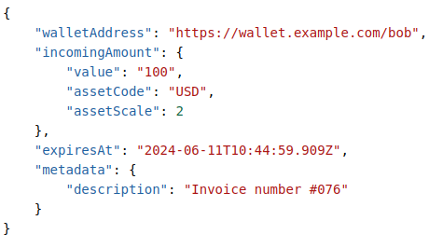
Deep Dive: Open Payment Flows
Incoming payment request
Specify the amount the recipient should receive:
Include an incomingAmount value
Specify the amount the sender is sending:
Excluding the incomingAmount in the incoming payment request
Include a debitAmount of the amount you want to send within a Create Quote request (referred to as a fixed-send quote)

Slide 40
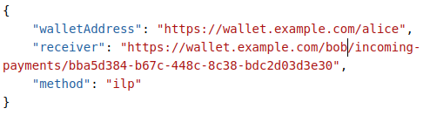
Deep Dive: Open Payment Flows
Quote
Fixed-receive quote - A fixed amount will be paid into the recipient’s account. receiveAmount is required.
Quote with defined incomingAmount - The receiver is the URL of the incoming-payment resource that will be paid into.
Fixed-send quote - A fixed amount will be paid from the sender’s account. debitAmount is required.
Notes:
This is the fees explanation. Double check what wallet the attendees are using. Can we pre sign them up?

Slide 41

Documentation: Wallet Addresses
https://openpayments.dev/introduction/wallet-addresses/

Slide 42
Deep Dive: Open Payment Flows
Wallet Addresses
Different configuration options:
One account can be defined by a single wallet address.
One account can have multiple wallet addresses pointing to it.
Allowing account holders to generate unique wallet addresses for every client they interact with can help prevent a single address from becoming a tracking vector.
A single wallet address can also represent all of a user’s accounts.
This way the provider determines which one of the accounts should receive the payment based on the currency type or some other agreed upon criteria.

Slide 43

Documentation: GNAP
https://openpayments.dev/introduction/grants/

Slide 44
Deep Dive: Authorization
Authorization Protocols
Giving a third party access to your resources
E.g. OAuth and GNAP
Authorization: User grants permission to the third-party app to access specific resources.
Access Token: Service (authorization server) provides the third-party app with an access token.
Resource Access: The third-party app uses the token to access the user’s resources from the service (resource server).

Slide 45
What makes GNAP a good fit?
Gives end users (customers) fine-grained control over:
What resources they are granting access to
Incoming payments / quotes / outgoing payments
What kinds of access they are granting
Read / write / update / delete
How often they are granting this access
Once off / repeated / monthly / weekly

Slide 46

Deep Dive: Authorization
Who’s Who
Client
Client
Customer
ASE
Wallet address server
Resource server (RS)
Authorization server (AS)
Identity provider (IdP)
Customer / Sender
Customer / Recipient
ASE
ASE
Wallet address server
Resource server
Wallet address server
Resource server
Authorization server (AS)
Identity provider (IdP)
Authorization server (AS)
Identity provider (IdP)

Slide 47
Deep Dive: Authorization
Grant Negotiation and Authorization Protocol
Open Payments uses the Grant Negotiation and Authorization Protocol (GNAP) to give the client application authorization to use the Open Payments API to interface with a customer’s account.
An authorization server (AS) implements the GNAP standard in order to give clients access tokens.
Clients use the access tokens to access resources on the resource server (RS), on the customer’s behalf.
Client
Customer
ASE
Authorization server (AS)
Resource server

Slide 48

Documentation: Creating Grants
https://openpayments.dev/guides/create-interactive-grant/

Slide 49
OP Concepts: Grants
A grant indicates a transfer of authorization from a resource owner (RO) to a piece of software (the client application).
Grant types match our resource types:
Incoming payment
Quote
Outgoing payment
Grants serve as a request from the client to the authorization server. Once the grant is validated, it can be exchanged for access tokens.
Grants are typically short-lived or single-use in many cases.

Slide 50
Deep Dive: Grant Flows
Non-interactive grant flows
Before a client can access the Open Payments API, it must send a grant request to the AS.
The request must contain the type of resource it wants to work with and the action(s) it wants to take on the resource.
Resource types include incoming-payment, quote, and outgoing-payment.
The available actions depend on type, but examples include create and read.
Client
Grant Request
Customer
ASE
Authorization server (AS)
Resource server

Slide 51
Deep Dive: Grant Flows
Non-interactive grant flows
A successful grant request results in the AS returning one or more access tokens to the client.
Access tokens represent a set of access rights and/or attributes granted to the client.
Client
Access token
Customer
ASE
Authorization server (AS)
Resource server

Slide 52
Deep Dive: Grant Flows
Non-interactive grant flows
With the access token(s), the client can access a resource server’s (RS) Open Payments API and perform authorized operations.
E.g. creating incoming payments on behalf of the resource owner (the customer).
Client
Request + Access token
Customer
ASE
Authorization server (AS)
Resource server

Slide 53
Deep Dive: Grant Flows
Interactive grant flows
Upon receiving a grant request, the authorization server redirects the client to the identity provider.
Client
Grant Request
Customer
Authorization server (AS)
ASE
Resource server
Identity Provider (IdP)
Notes:
The only interactive grant, when user gives explicit consent.
The account holder of the sending wallet will have an identity provider set up with their ASE, so they have login credentials or whatever, and then whenever an outgoing payment is being made, you need consent from that person. The identity provider proves to the ASE that consent is coming from the wallet owner.
Client application never talks to the identity provider.
Use the banking application function as the explanation, it’s the same concept.

Slide 54
Deep Dive: Grant Flows
Interactive grant flows
The identity provider must check that it’s talking to the customer, then get the customer’s consent.
Once it has the customer’s consent, it redirects back to the client.
Client
Grant Request
Customer
Authorization server (AS)
Do you consent?
ASE
Resource server
Yes!
Identity Provider (IdP)
Notes:
The only interactive grant, when user gives explicit consent.
The account holder of the sending wallet will have an identity provider set up with their ASE, so they have login credentials or whatever, and then whenever an outgoing payment is being made, you need consent from that person. The identity provider proves to the ASE that consent is coming from the wallet owner.
Client application never talks to the identity provider.
Use the banking application function as the explanation, it’s the same concept.

Slide 55
Deep Dive: Grant Flows
Interactive grant flows
The client sends a grant continuation request to the AS.
Client
Grant Continuation Request
Customer
Authorization server (AS)
ASE
Resource server
Identity Provider (IdP)
Notes:
The only interactive grant, when user gives explicit consent.
The account holder of the sending wallet will have an identity provider set up with their ASE, so they have login credentials or whatever, and then whenever an outgoing payment is being made, you need consent from that person. The identity provider proves to the ASE that consent is coming from the wallet owner.
Client application never talks to the identity provider.
Use the banking application function as the explanation, it’s the same concept.

Slide 56
Deep Dive: Grant Flows
Interactive grant flows
The AS can then grant an access token to the client application.
Now the client can continue making requests to the resource server (RS) with its access token(s).
Client
Access token
Customer
Authorization server (AS)
ASE
Resource server
Identity Provider (IdP)

Slide 57

Documentation: Client Keys
https://openpayments.dev/introduction/client-keys/

Slide 58
OP Concepts: Client Keys
All client requests in Open Payments are signed using a unique key that identifies the client to the authorization and resource servers.
A client must generate and add its key to a key registry before requesting a grant for the first time. Each client is represented by its own wallet address.
A key registry is a list of keys associated with client applications.
Key registries are publicly exposed endpoints. Servers can retrieve the client’s key registry by accessing WALLET_ADDRESS/jwks.json
This allows servers to verify that a client is who they says they are.
Notes:
Ask Max to explain this bit more

Slide 59
OP Concepts: Asymmetric Keys
Each client generates a key pair: a public key and a private key.
Public key is registered with the Account Servicing Entity (ASE) in a key registry.
Clients sign their request using their private key.
ASE verifies the signature using the client's public key that is associated with them in the key registry.
This ensures the request is from the legitimate client and hasn't been tampered with.
Non-repudiation: The client cannot deny sending the request.
Purpose: integrity and authenticity, NOT privacy.
Notes:
Ask Max to explain this bit more

Slide 60
OP Concepts: Access Tokens
An access token is issued by the authorization server.
It is used by the client to access specific resources on the resource server.
A client will produce the access token to a resource server to access protected resources.
Access tokens can be short or long lived.

Slide 61
What about security?
Successful grant requests result in access tokens.
Access tokens ensure that only authorized operations are executed.
We’re still left with two very important questions:
How do we know we can trust that the client sending the request is who they say they are?
How can we be sure that the request hasn’t been tampered with?

Slide 62

Documentation: HTTP message signatures
https://openpayments.dev/introduction/http-signatures/

Slide 63
Digital Signatures
Client Side: Creating The Signature
Inputs:
Request data
Client's private key
Process:
The request data is hashed (converted into a fixed-size string).
The hash is encrypted with the client's private key, creating the signature.
Output:
The signature is a unique encrypted string.
Notes:
SDK does signing for you.
If you’re not using Typescript/Javascript, then you have to bring in your own
Ask Max.

Slide 64
Digital Signatures
Server Side: Verifying The Signature
Inputs:
Received request data
Signature from the request
Client's public key
Process:
The server hashes the received request data.
The server decrypts the signature using the client’s public key to get the original hash.
The server compares both hashes. If the hashes match, the signature is valid.

